Slide 1
RIDESHARE
Abhiram Venkata Daita(21r11a05a6)​
Muddam Sai Manish Yadav(21r11a05d5)​
Ragi Rakshitha Reddy(21r11a05e1)​

Slide 2
ABSTARCT
EXISTING SYSTEM
PROPOSED SYSTEM
SYSTEM CONFIGURATION
WORK FLOW
IMPLEMENTATION
OUTPUT SCREENS
FURTHER ENHANCEMENTS
CONCLUSION
AGENDA

Slide 3
ABSTRACT
In urban settings, transportation poses a significant challenge, often leading to inefficiencies and increased costs for commuters. To address this issue, we propose RideShare, a cab booking system that enables users traveling from one location to another to share the cost of their journey with fellow travelers. This project aims to enhance convenience, affordability, and sustainability in transportation by leveraging technology to facilitate ridesharing among users.
RideShare will be developed using modern web development technologies and APIs. The backend will be built using Django, a Python-based framework, coupled with PostgreSQL for data storage. Authentication and authorization will be implemented to ensure secure access to the platform. Mapping functionalities will be integrated using the Mapbox API to enable users to specify pickup and drop-off locations accurately. Real-time communication between users will be facilitated through ajax technology, allowing for seamless coordination of ridesharing arrangements.
The implementation of RideShare will result in a user-friendly platform that empowers users to find and offer rides conveniently. By enabling users to share the cost of their journeys, RideShare will promote cost savings and reduce the environmental impact of transportation. Real-time communication features will enhance user experience.

Slide 4
EXISTING SYSTEM
Carpooling platforms like BlaBlaCar, Uber, Ola has revolutionized how people share rides, offering a cost-effective and eco-friendly alternative to traditional transportation methods.
However, despite their popularity, these systems come with certain limitations and challenges that affect user experience, safety, and cost efficiency.
Existing System Challenges
Safety and comforts
Flexibility Limitations for Publishers
Limited Transparency
User Experience Issues

Slide 5
PROPOSED SYSTEM
In response to the challenges faced by existing carpooling platforms, our proposed system, RideShare, is designed to overcome these limitations by offering a more user-friendly, secure, and flexible experience. RideShare integrates several key features aimed at addressing the shortcomings of traditional carpooling services.
Proposed System advantages
Rating System for Publishers and Passengers
Accept/Reject Mechanism for Publishers.
Flexible Scheduling for Publishers
Transparency

Slide 6
SYSTEM CONFIGURATION
Software Requirements:
WEB BROWSER GOOGLE OR ANY COMPACTIBLE BROWSER
Operating System: Windows 7 or higher
Development Tools: Visual Studio Code
Development Framework: Django
Database: PostgreSQL
Frontend Technologies: HTML, CSS, JavaScript
API: Mapbox API
Hardware Requirements:
System: Intel i5
Memory: Minimum 4 GB RAM.
Internet: Stable internet connection.

Slide 7
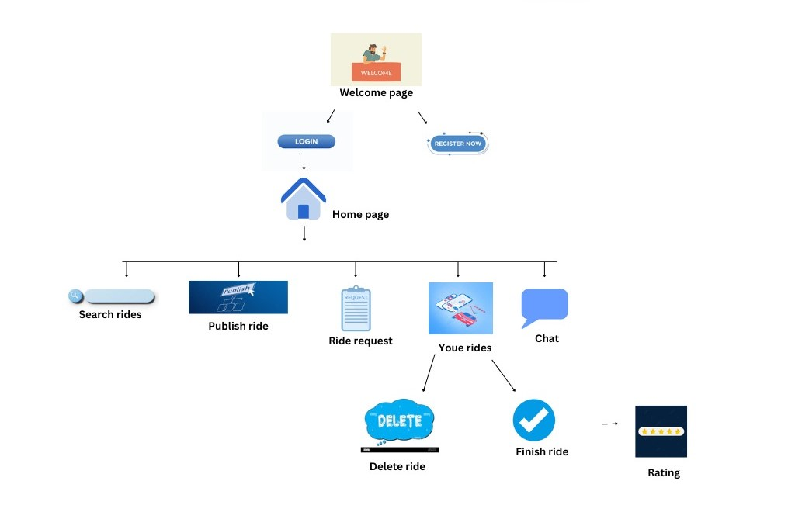
WORK FLOW

Slide 8
IMPLEMENTATION
Set Up Development Environment and Database Configuration
User Authentication
Publishing and Searching for Rides
Ride Requests and Ride Management
Rating system
Chat and Notification System

Slide 9
OUTPUT SCREENS

Slide 10
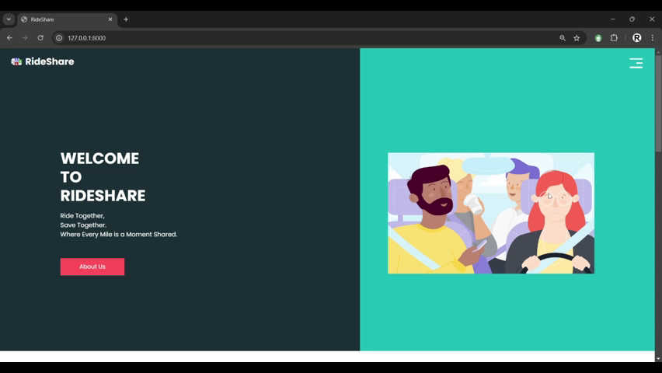

Slide 11
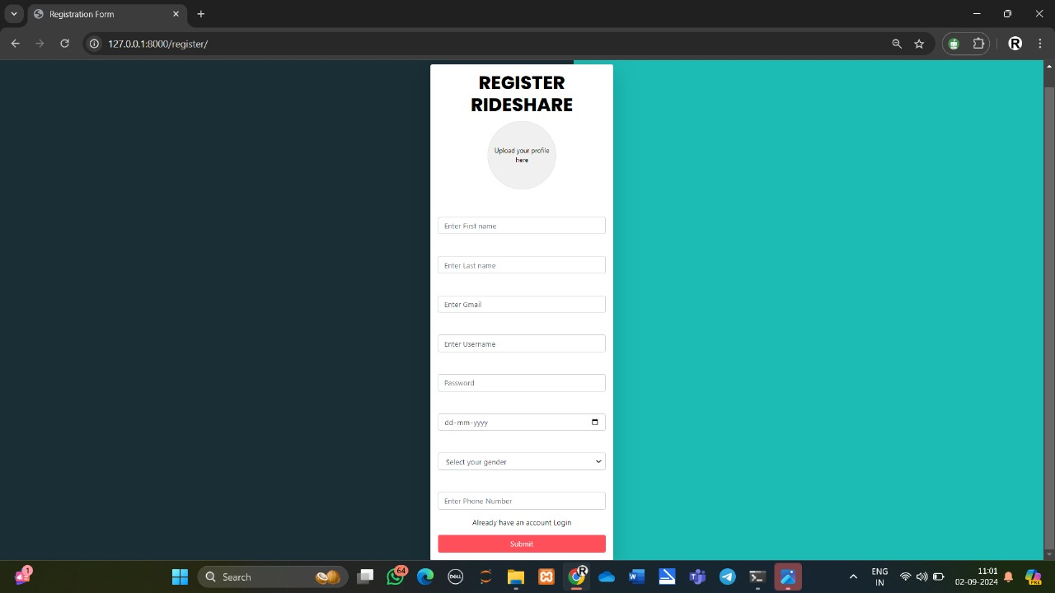

Slide 12
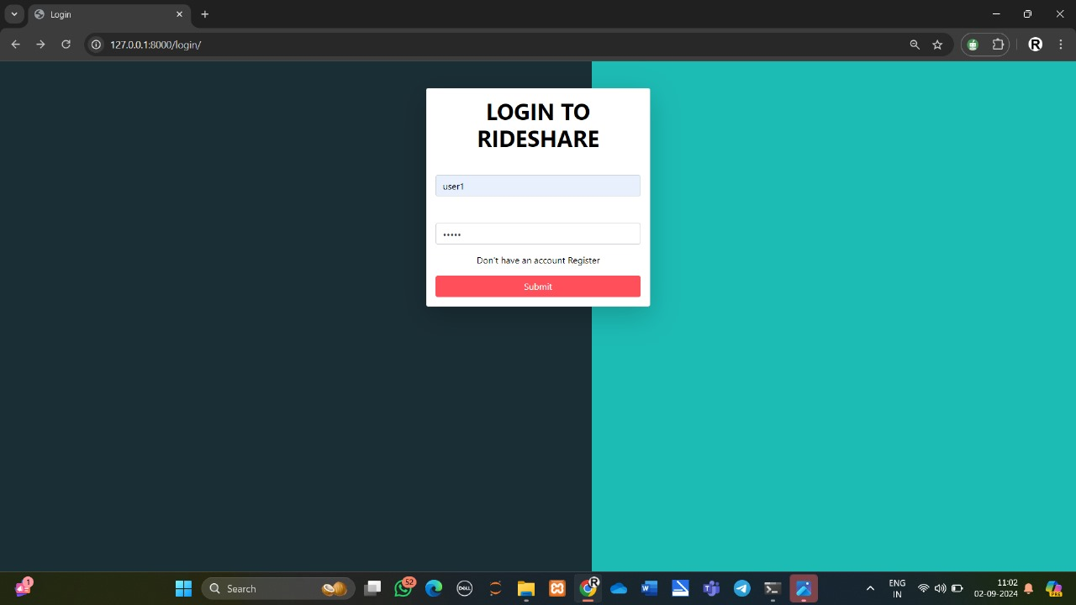

Slide 13
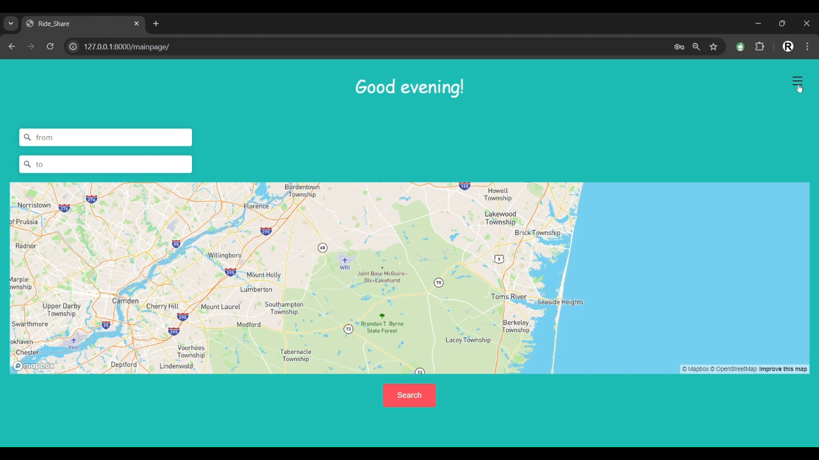

Slide 14
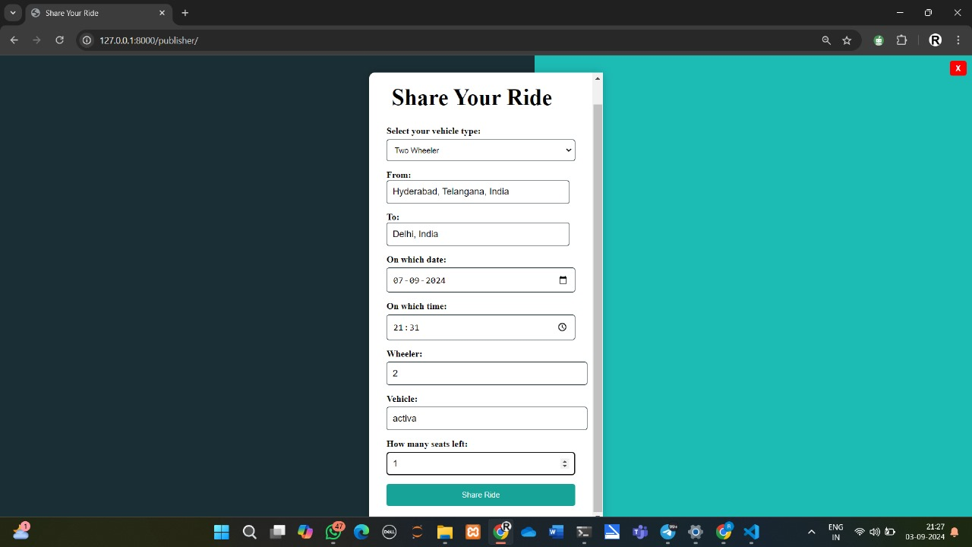

Slide 15
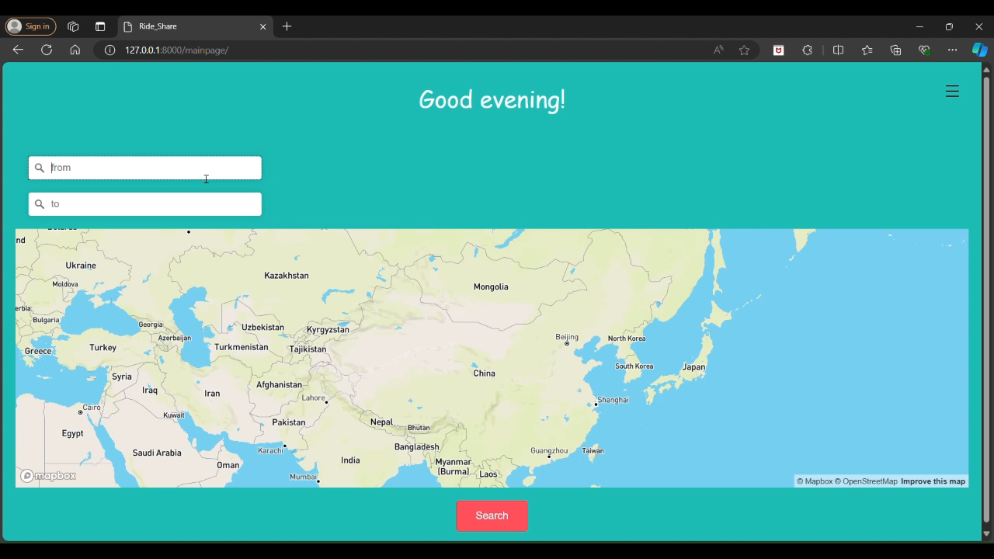

Slide 16
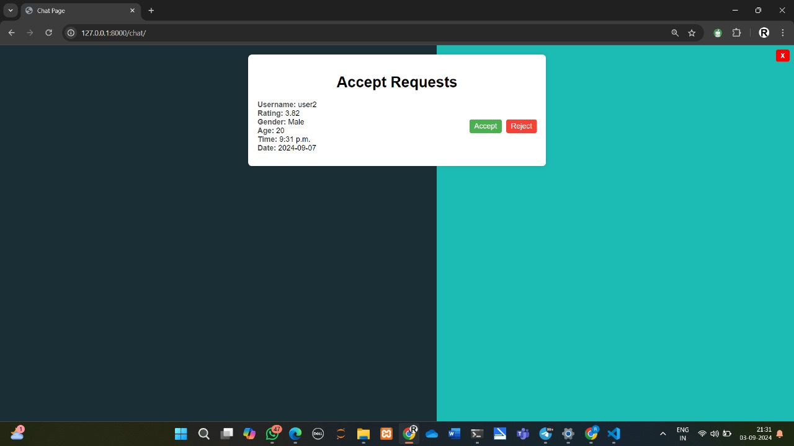

Slide 17
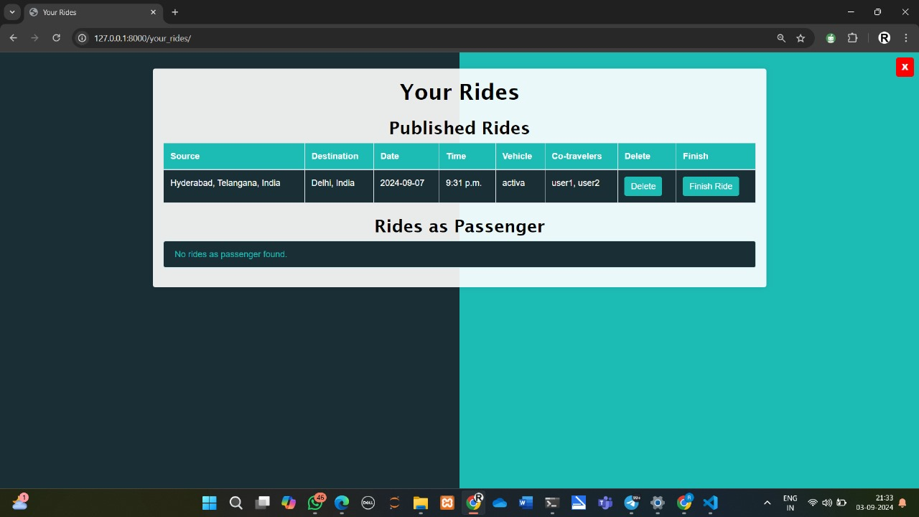

Slide 18
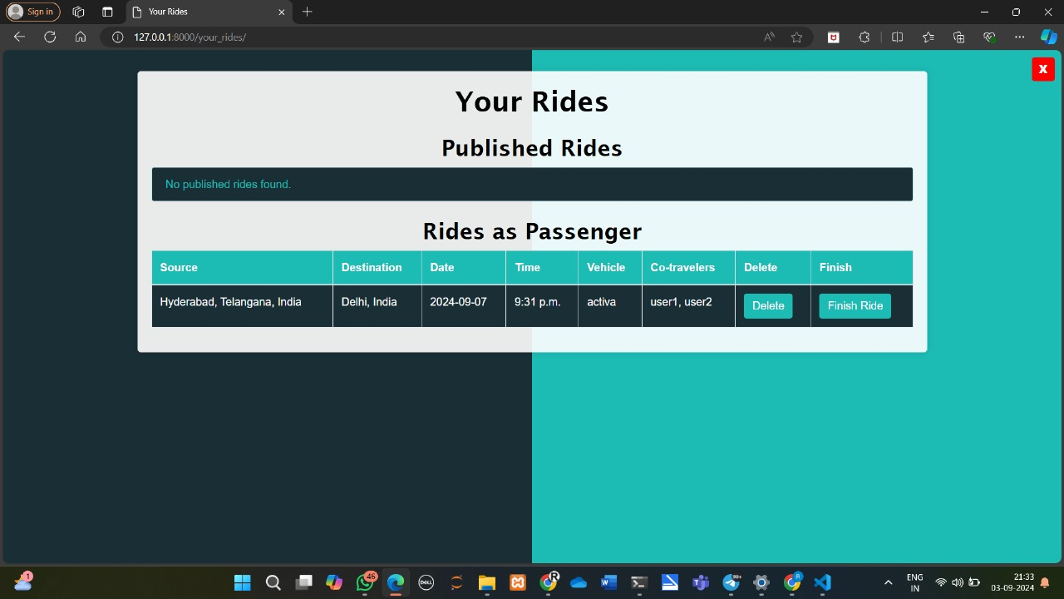

Slide 19
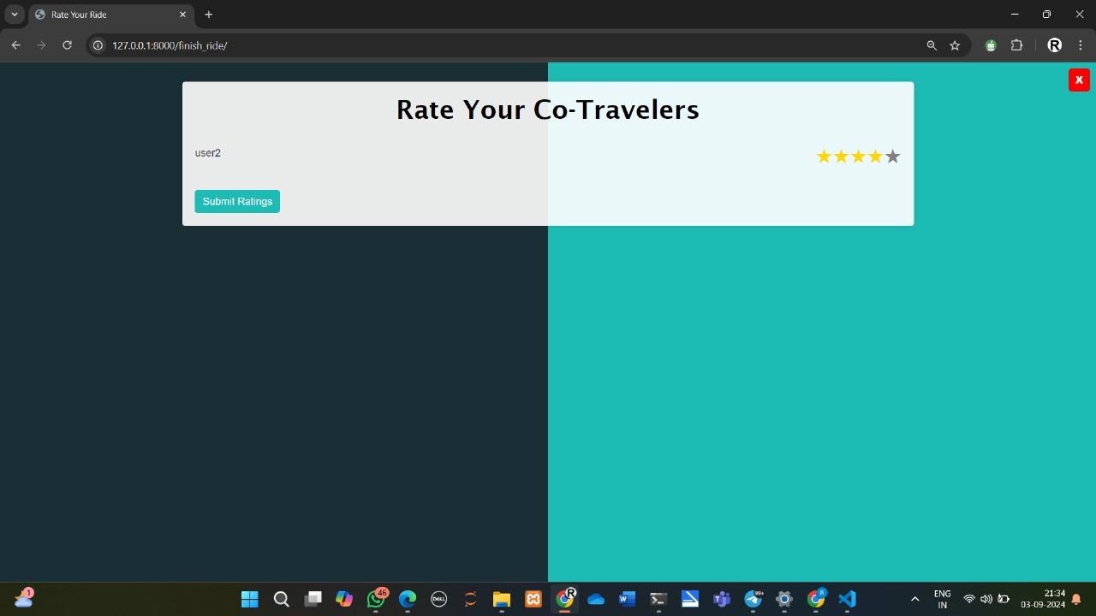

Slide 20
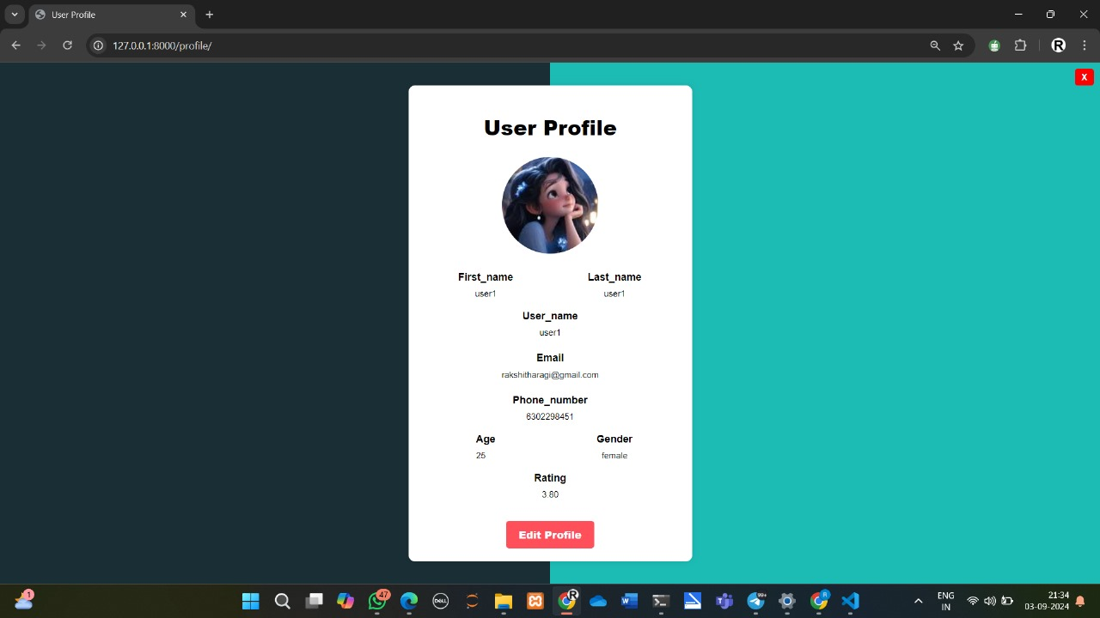

Slide 21
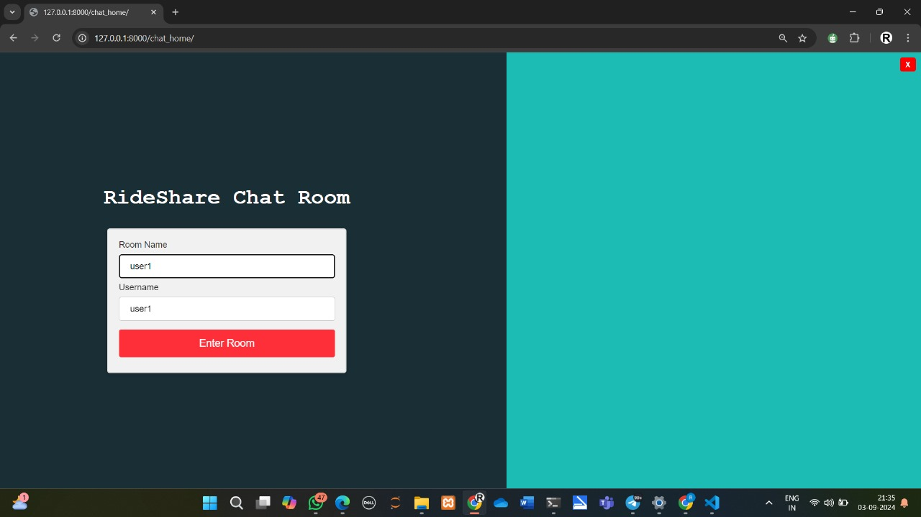

Slide 22
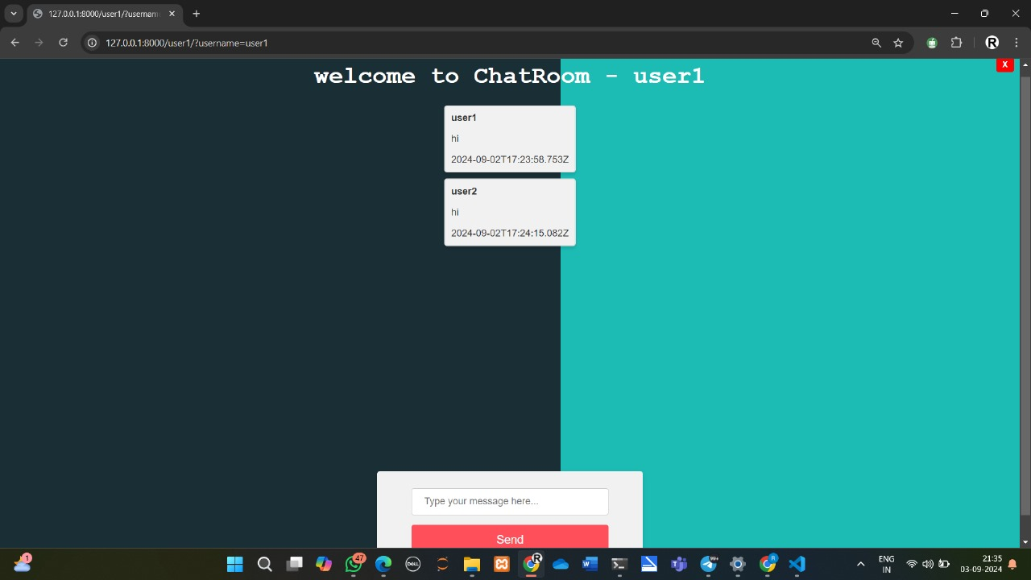

Slide 23
FURTHER ENHANCEMENTS
1.Mobile Application Development: Transition the web-based application to a mobile app to increase accessibility and user convenience.
2.Live Location Tracking: Integrate live location tracking for rides to provide real-time updates and improve safety.
3.Integration with Payment Gateways: Introduce payment gateway integration to facilitate secure transactions and handle ride payments directly through the platform.
4.Dynamic Pricing Model: Introduce a dynamic pricing model that adjusts costs based on distance, demand, and other factors.
5. WhatsApp Integration: Implement a "Contact via WhatsApp" feature to facilitate real-time communication between users, allowing for seamless and familiar messaging.

Slide 24
CONCLUSION
In summary, our RideShare project represents a significant step forward in the world of carpooling. By leveraging the Django framework and integrating modern technologies, we have created a platform that:
Facilitates Efficient Carpooling: Allows users to easily publish and find rides, reducing the hassle of traditional carpool arrangements.
Promotes Environmental Sustainability: Helps decrease traffic congestion and lowers carbon emissions by encouraging shared transportation.
Enhances User Experience: Offers features such as real-time chat, a comprehensive rating system, and location suggestions for a smooth and reliable user experience.

Slide 25
ANY QUERIES ?

Slide 26
THANK YOU

